Slide 1
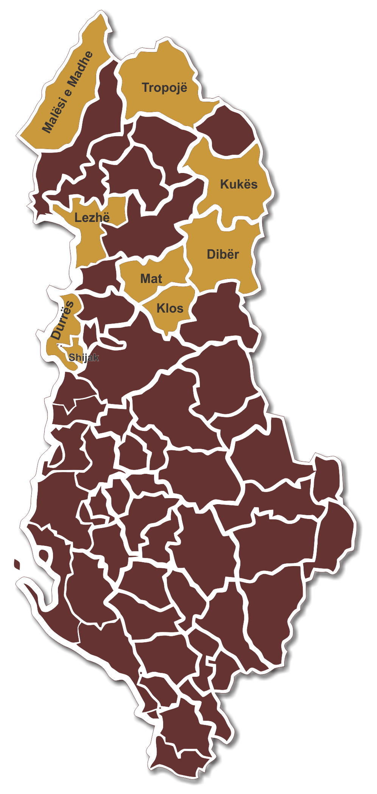

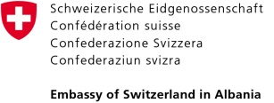



Organizational structure according to FAP
Case of Lezha & others
Functional Area Program
PRACTICES AND LEARNINGS IN FUNCTION OF CONSOLIDATION OF THE TERRITORIAL AND ADMINISTRATIVE REFORME

Slide 2

Challenges according to FAP
Increased diversity in the territory
Urban areas, agricultural, seaside and mountain
Diversity of services
From multi-storey buildings permits to control of irrigation
Space for increased role of the Municipality for the development orientation
Strengthenning of the planning and regulatory role
Proactive instead of following development
Services to citizens
From waste management to the economic aid and land ownership certificates
Network of services with the citizens in center
Social cohesion
Programme for Decentralization and Local Development (dldp) | www.dldp.al | www.km.dldp.al | dldp@helvetas.org

Slide 3
Municipality’s role in development
Development promotor / facilitator:
Identificationof sectors with higher potential for development in the FA
Accelerating growth opportunities
Not only by creating conditions and enabling the infrastructure;
But also innovative projects, multipliers of local / cohesion growth
Programme for Decentralization and Local Development (dldp) | www.dldp.al | www.km.dldp.al | dldp@helvetas.org

Slide 4
Enabling conditions for this role
Change of mentality at local level
New energies for a pro-active role
Good knowledge of the territory and challenges (FAP)
Technical expertise
Entirely new sectroial policies (agriculture, agrobusiness, tuorism, industry…)
Strenthening of technical capacities for planning and implementation within the Municipality /in political and executive level and/or
Formalization of the cooperation with deconcentrated agencies
Increase and standardizing of Services
Maintain actual level of service delivery
Strategy for service delivery based on economy of scale
Use of ICT
Sabina: Duhet theksuar nevoja per ndryshimet/permiresimet ligjore
Programme for Decentralization and Local Development (dldp) | www.dldp.al | www.km.dldp.al | dldp@helvetas.org

Slide 5
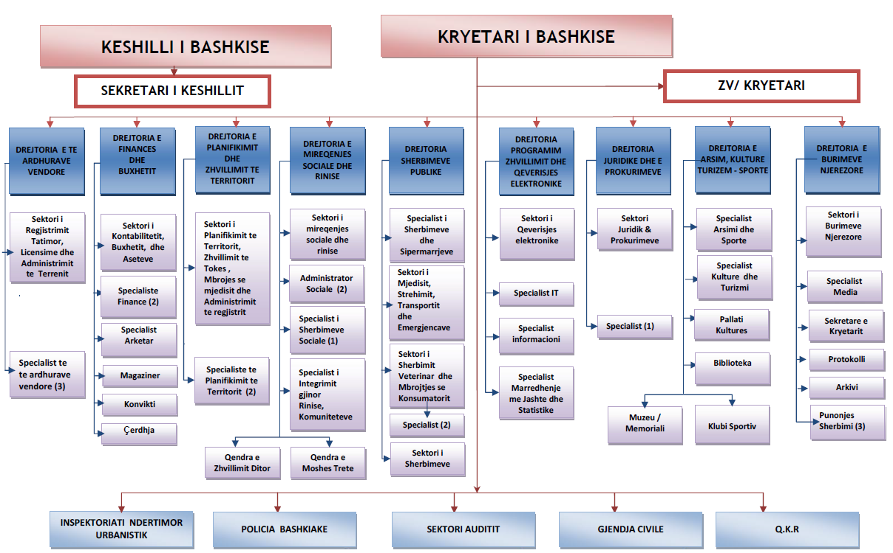
Actual typical structure
Municipality of Lezhë today
Programme for Decentralization and Local Development (dldp) | www.dldp.al | www.km.dldp.al | dldp@helvetas.org

Slide 6
Proposed structure
Develoment Policies
Strategic planning of economic and sectorial development; social and economic cohesion; service policies and standards; assesment and forecasts
Regulatory tasks
Service Delivery
Support services
Finance
Legal services
Procurement
Human resources
ICT
Income
Processes of licences; permits; acreditations; and inspections. These functions should be separated by the process of definition of regulations (policies) and by the direct services.
Services to the community (cleaning, maintanance of infrastructures, etc.).
Planning of social and cultural issues
Territory planning
Direct services (to citizens)
Programme for Decentralization and Local Development (dldp) | www.dldp.al | www.km.dldp.al | dldp@helvetas.org

Slide 7
Proposed structure
Main principles
The accumulated experience in designing LGUs’ structures
Compliance with the sectorial legal framework
Civil Servant Law
General principles of structure and functions of government
The need for approximation/uniformization of civil service structures at central and local level
Programme for Decentralization and Local Development (dldp) | www.dldp.al | www.km.dldp.al | dldp@helvetas.org

Slide 8
Proposed structure
Secretary General /
Administrator
Development Policies Directorate
Regulatory Directorate
Service Menagement Directorate
Support Services Directorate
Mayor
Mayor’s Cabinet
Deputy
Mayor
Communitary Services
Direct Services
Administrative Units
Internal
Audit
Interconnects the political level with the civil service
Ensures sustainability and decreases the administrative load of Mayor
Monitors, coordinates and ensures efficency
Programme for Decentralization and Local Development (dldp) | www.dldp.al | www.km.dldp.al | dldp@helvetas.org

Slide 9
How to integrate the actual and the proposed structures
Sekretari i Pergjithshem
Drejtoria e Planifikimit Urban
Sekt. i Masterplnaneve
Sekt. GIS Kadaster
Sekt. Projektimit dhe Standardiizimit
Sekt. i Politikave Mjedisore
Sekt. i Mikroplanifikimit
Drejtoria e Sherbimeve Rregullatore
Sekt. i Zhvillimit Urbanistik
Drejtoria e Manaxhimit te Sherbimeve
Drejtoria e Sherbimeve te DPD
DRejtoria e Planifikimit Strategjik dhe Zhvillimit
Drejtoria e Zhvillimit Ekonomik
Drejtoria e Politikave dhe Standadeve te Liicensimit
Sektori i Lehtesimit te Biznesit
Drejtoria e Rrjeteve te Infrastruktures
Drejjtoria Ceshtjeve Sociale, Arsimit dhe Rinise
Drejtoria e Transportit dhe Levizshmeriise
Drejtoria e Monitorimit dhe Statistikave
Sekt i Kontrollit te Territorit Urban
Qendra e Regjistrimit dhe Licencave
Sherbimet komunitare
Sherbimet Sociale dhe Strehimi
Gjendja Civile
Kontrolli Jo Ushqimor
Kontrolli i Qendrave dhe Sherbimeve Komunitare
Kontrolli Veterinar dhe Zooteknik
Shqyrtimi i Aplikimeve
Legalizimi dhe Shpronsimi
Kontrolli i Zbatimit te Lejeve
Sekretariati Teknik
Njesia e Menaxhimit dhe Referrimit te Rasteve
Njesia e Perfitimeve cash (NE&PAK)
Sektori i Strehimit
Menaxhimi i Siperfaqeve Urbane
Sherbimet e Ndertesave
Ndermarrje Varesie
Menaxhimi i Mjedisit
Pastrimi i Qytetit
Trajtimi i Mbetjeve
Ndermarrje Varesie
Promovimi i Qytetit
Njesite Administrative
Drejtoria e sherbimeve mbeshtetese
Drejtoria e Burimeve Njerezore
Drejtoria e Finances
Drejtoria Juridike
Drejtoria e IT
Drejtoria e Buxhetit
Njesia Koordinuese
Programme for Decentralization and Local Development (dldp) | www.dldp.al | www.km.dldp.al | dldp@helvetas.org

Slide 10
IOSSH for services to citizens
Offices that actually deliver services, organized within the 4 proposed pillars
Income Office
Legal Office
Finance Office
Development Policies
Service delivery
Support services
Regulatory Tasks
Agriculture Office
Public Services Office
Housing Office
Housing Office
Protocol and Archive Office
Road transportation Office
Veterinary Office
Social Assistance and Services Office
Social Assistance and Services Office
Territory Planning and Control Office
Territory Planning and Control Office
Administrative Units
Endri: duhet theksuar fakti qe me skemen qe propozohet, zyrat aktuale do jene me shume te fokusura ne politika zhvillimi dhe me pak te detyrat rregullatore dhe ofrimi i sherbimeve
Programme for Decentralization and Local Development (dldp) | www.dldp.al | www.km.dldp.al | dldp@helvetas.org

Slide 11
IOSSH for delivering services to citizens
Workload of 1 month
Requests per month
Offices | Municipality | Commune | Total
Office for economic aid and social services | 315.5 | 29.5 | 345
Office of Road transporting | 42 | 4.5 | 46.5
Public Service Office | 34.5 | 18 | 52.5
Office for territory planning and controle | 32 | 7.5 | 39.5
Income Office | 27 | 9 | 36
Legal Office | 14.5 | 8.5 | 23
Veterinary Office | 8 | 4 | 12
Housing Office | 6 | 0 | 6
Protocol and Archive Office | 4.5 | 1.5 | 6
Finance Office | 4 | 4 | 8
Agriculture Office | 0 | 0 | 0
Veterinary Office + Agriculture Office | 0 | 13 | 13
Grand Total | 488 | 99.5 | 587.5
Programme for Decentralization and Local Development (dldp) | www.dldp.al | www.km.dldp.al | dldp@helvetas.org

Slide 12
IOSSH for delivering services to citizens
Municipality’s structure – transitory phase
Production Offices
Secretary general
Coordination Office
Service Management Directorate
Municipality
IOSSH
Administrative Unit
Administrator
Services Office (Responsible)
Counter 1
Social Assistance
Counter 2
Counter 3
Non digitallized
Partially digitalized
Administrator
Office responsible
Social Assistance
Road Transport
Public Services
Income
Agriculture
Farming
Administrative Unit
Programme for Decentralization and Local Development (dldp) | www.dldp.al | www.km.dldp.al | dldp@helvetas.org

Slide 13
Where to orient organization and strengthening of capacities under the new context?
Secretary General / Administrator
Definition of tasks and competencies
Cabinet
Definition of tasks and competencies in policy making
ICT sector
Expand and strengthen capacities
Administrative Units
Expertize for development policies
Definition of tasks and competencies of the Administrator
Profiling and strengthening of expertise according to priority sectors vs. strengthening the relations with deconcentrated agencies
Adopt HR to OSSH
Programme for Decentralization and Local Development (dldp) | www.dldp.al | www.km.dldp.al | dldp@helvetas.org

Slide 14
Functional Area Program
Thank You!
Programi për Decentralizim dhe Zhvillim Lokal (dldp) | www.dldp.al | www.km.dldp.al | dldp@helvetas.org
Programme for Decentralization and Local Development (dldp) | www.dldp.al | www.km.dldp.al | dldp@helvetas.org

